Slide 1
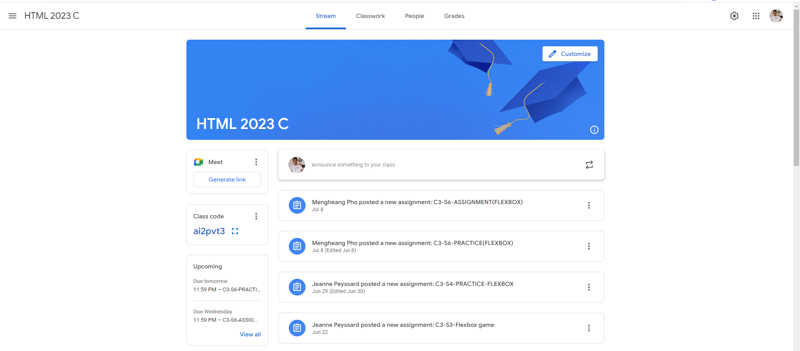
Identify root components of website below

Slide 2
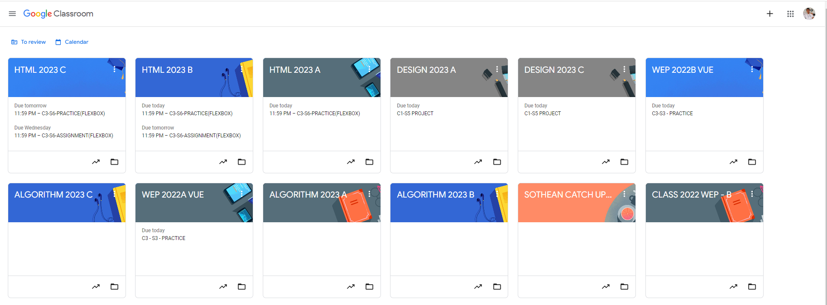
Root div
- Height: 100vh
content
nav
Flex: 0
header
Flex: 0
Flex: 1

Slide 3
Flex: 2
Flex: 1
Nav-left
Nav-right
Flex-direction : row

Slide 4
Flex-direction : row
Flex: 0
Header-bar

Slide 5
Flex: 1
Main-content

Slide 6
Content-head
Content-info
Content-option
Flex: 1
Flex: 0
Flex: 0
Flex-direction : column

